Slide 1
Cloud -Types
Cloud computing has two distinct sets of models: NSIT, Cloud Cube Model
Deployment models:
This refers to the location and management of the cloud’s infrastructure.
Service models:
This consists of the particular types of services that you can access on a cloud computing platform.
NIST model
The United States government is a major consumer of computer services and, therefore, one of the major users of cloud computing networks.
The U.S. National Institute of Standards and Technology (NIST) has a set of working definitions (http://csrc.nist.gov/groups/SNS/cloud-computing/cloud-def-v15.doc) that separate cloud computing into service models and deployment models.
The NIST model originally did not require a cloud to use virtualization to pool resources, nor did it absolutely require that a cloud support multi-tenancy in the earliest definitions of cloud computing.
Multi-tenancy is the sharing of resources among two or more clients. The latest version of the NIST definition does require that cloud computing networks use virtualization and support multi-tenancy.

Slide 2
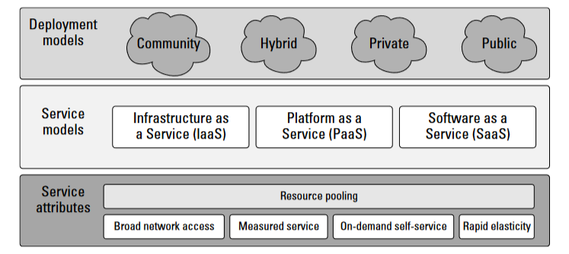
Cloud –NSIT Model
The NIST cloud model doesn’t address a number of intermediary services such as transaction or service brokers, provisioning, integration, and interoperability services that form the basis for many cloud computing discussions.

Slide 3
Cloud Cube Model
The Open Group maintains an association called the Jericho Forum (https://www.open group.org/jericho/index.htm) whose main focus is how to protect cloud networks.
The group has an interesting model that attempts to categorize a cloud network based on four dimen- sional factors.
Paper-“Cloud Cube Model: Selecting Cloud Formations for Secure Collaboration” (http://www.opengroup.org/jericho/cloud_cube_model_v1.0.pdf), the type of cloud networks you use dramatically changes the notion of where the boundary between the client’s network and the cloud begins and ends.
The four dimensions of the Cloud Cube Model are:
Physical location of the data: Internal (I) / External (E) determines your organization’s boundaries.
Ownership: Proprietary (P) / Open (O) is a measure of not only the technology ownership, but of interoperability, ease of data transfer, and degree of vendor application lock-in.
Security boundary: Perimeterised (Per) / De-perimiterised (D-p) is a measure of whether the operation is inside or outside the security boundary or network firewall.
Sourcing: Insourced or Outsourced means whether the service is provided by the customer or the service provider.

Slide 4
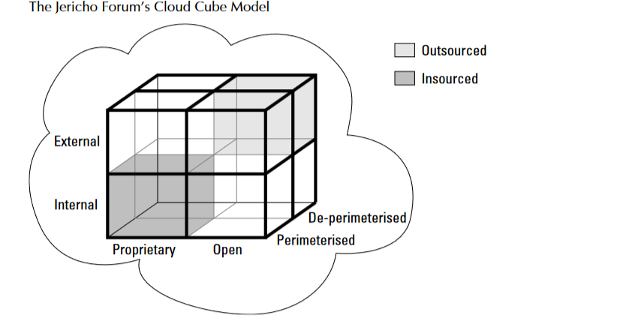
Cloud Cube Model
The fourth dimension corresponds to two different states in the eight possible cloud forms
Per (IP, IO, EP, EO)
and D- p (IP, IO, EP, EO).
The sourcing dimension addresses the deliverer of the service.
What the Cloud Cube Model is meant to show is that the traditional notion of a network boundary being the network’s firewall no longer applies in cloud computing.

Slide 5
Deployment Models
A deployment model defines the purpose of the cloud and the nature of how the cloud is located.
The NIST definition for the four deployment models:
Public cloud: The public cloud infrastructure is available for public use alternatively for a large industry group and is owned by an organization selling cloud services.
Private cloud: The private cloud infrastructure is operated for the exclusive use of an organization. The cloud may be managed by that organization or a third party. Private clouds may be either on- or off-premises.
Hybrid cloud:
A hybrid cloud combines multiple clouds (private, community of public) where those clouds retain their unique identities, but are bound together as a unit.
Hybrid cloud may offer standardized or proprietary access to data and applications, as well as application portability.

Slide 6
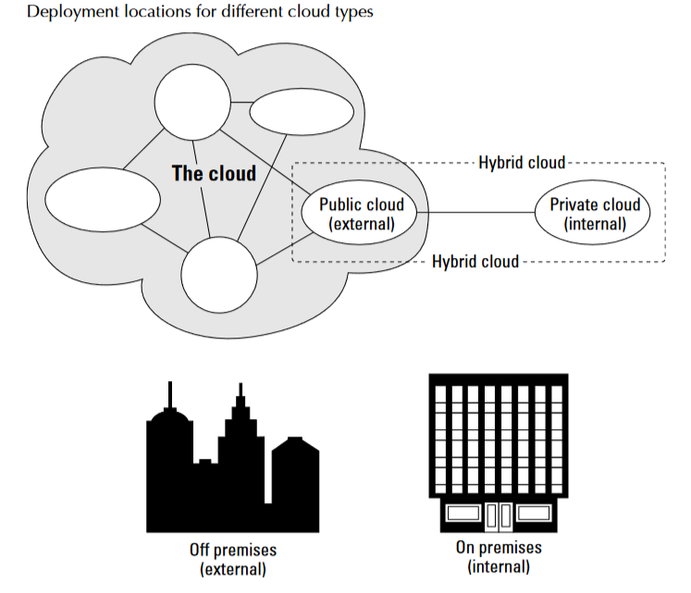
Deployment Models
Community Cloud:
It is one where the cloud has been organized to serve a common function or purpose.
It may be for one organization or for several organizations, but they share common concerns such as their mission, policies, security, regulatory compliance needs, and so on.
A community cloud may be managed by the constituent organization(s) or by a third party.

Slide 7
Deployment Models
Community Cloud:
The United States Government, under the auspices of the General Services Administrator (GSA), launched a cloud computing portal called Apps.gov.
The purpose of providing cloud services to federal agencies. Described under the “U.S. Federal Cloud Computing initiative (http://www.scribd.com/doc/17914883/US-Federal-Cloud-Computing- Initiative-RFQ-GSA).
The goal of the initiative is to make large portions of the federal govern- ment’s apparatus available under a cloud computing model.
This is a good example of a community cloud deployment, with the government being the community.

Slide 8
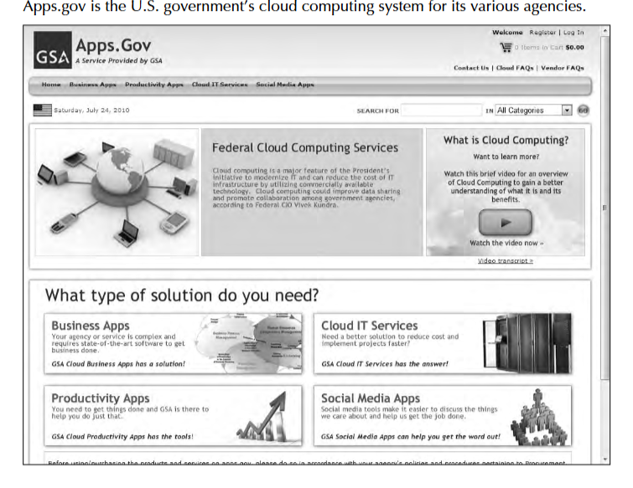
Deployment Models
.

Slide 9
Service Models
Cloud computing has developed, different vendors offer clouds that have different services associated with them.
There are many different service models described in the literature, all of which take the following form:
XaaS, or “<Something> as a Service”
Three service types have been universally accepted:
Infrastructure as a Service (IaaS):
IaaS provides virtual machines, virtual storage, virtual infrastructure, and other hardware assets as resources that clients can provision.
The IaaS service provider manages all the infrastructure, while the client is responsible for all other aspects of the deployment. This can include the operating system, applications, and user interactions with the system.

Slide 10
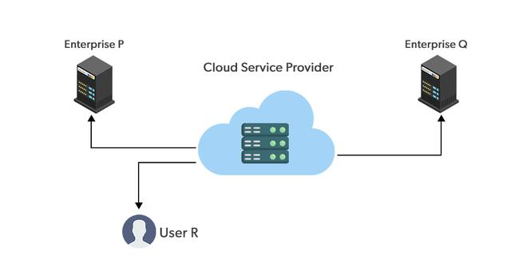
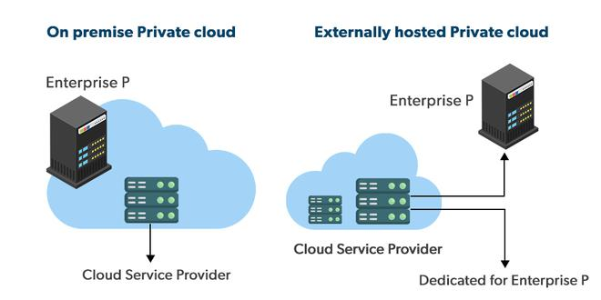
Cloud Deployment Models

Slide 11
Cloud Deployment Models
Factors | Public Cloud | Private Cloud | Hybrid Cloud
Resources | Resources are shared among multiple customers | Resources are shared with a single organization | It is a combination of public and private clouds. based on the requirement.
Tenancy | Data of multiple organizations is stored in the public cloud | Data of a single organization is stored in a clouds the public cloud | Data is stored in the public cloud, and provide security in the public cloud.
Pay Model | Pay what you used | Have a variety of pricing models | It can include a mix of public cloud pay-as-you-go pricing, and private cloud fixed pricing. It has other pricing models such as consumption-based, subscription-based, etc.
Operated by | Third-party service provider | Specific organization | Can be a combination of both
Scalability and Flexibility | It has more scalability and flexibility, | It has predictability and consistency | It has scalability and flexibility by allowing organizations to use a combination of public and private cloud services.
Expensive | less expensive | More expensive | Can be more expensive, but it can also be less expensive , depending on the specific needs and requirements of the organization.
Availability | The general public (over the internet) | Restricted to a specific organization | Can be a combination of both.

Slide 12
Service Models
Platform as a Service (Paas):
PaaS provides virtual machines, operating systems, applications, services, development frameworks, transactions, and control structures.
The client can deploy its applications on the cloud infrastructure or use applications that were programmed using languages and tools that are supported by the PaaS service provider.
The service provider manages the cloud infrastructure, the operating systems, and the enabling software. The client is responsible for installing and managing the application that it is deploying.
Software as a Service (SaaS )
It is a complete operating environment with applications, management, and the user interface.
In the SaaS model, the application is provided to the client through a thin client interface (a browser, usually), and the customer’s responsibility begins and ends with entering and managing its data and user interaction.
Everything from the application down to the infrastructure is the vendor’s responsibility.

Slide 13
Service Models
The three different service models taken together have come to be known as the SPI model of cloud computing. Many other service models have been mentioned: StaaS, Storage as a Service;
IdaaS, Identity as a Service; CmaaS, Compliance as a Service; and so forth. However, the SPI services encompass all the other possibilities.
It is useful to think of cloud computing’s service models in terms of a hardware/software stack. One such representation called the Cloud Reference Model.
At the bottom of the stack is the hardware or infrastructure that comprises the network. As you move upward in the stack, each service model inherits the capabilities of the service model beneath it.
IaaS has the least levels of integrated functionality and the lowest levels of integration, and SaaS has the most examples of IaaS service providers include: Amazon Elastic Compute Cloud (EC2), Eucalyptus, GoGrid, FlexiScale, Linode, Rack Space Cloud, Terremark.

Slide 14
Service Models
These vendors offer direct access to hardware resources. On Amazon EC2, considered the classic IaaS example, a client would provision a computer in the form of a virtual machine image, provision storage, and then go on to install the operating system and applications onto that virtual system.
Amazon has a number of operating systems and some enterprise applications that they offer on a rental basis to customers in the form of a number of canned images, but customers are free to install whatever software they want to run.
Amazon’s responsibilities as expressed in its Service Level Agreement, which is published on Amazon’s Web site, contractually obligates Amazon to provide a level of performance commensurate with the type of resource chosen, as well as a certain level of reliability as measured by the system’s uptime.

Slide 15
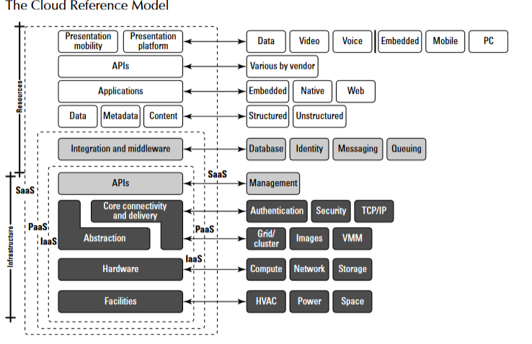
Service Models

Slide 16
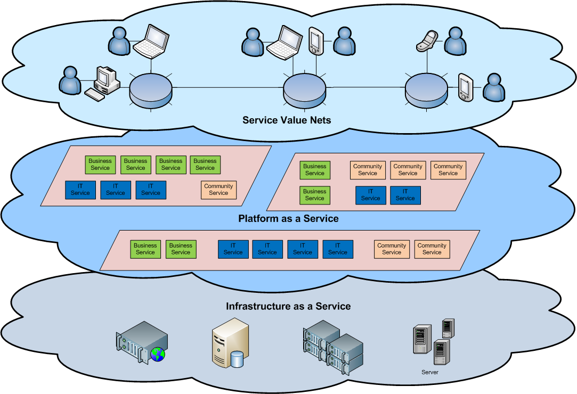
Cloud Service Models

Slide 17
Service Models
A PaaS service adds integration features, middleware, and other orchestration and choreography services to the IaaS model.
Examples of PaaS services are:Force.com, GoGrid CloudCenter, Google AppEngine, Windows Azure Platform.
When a cloud computing vendor offers software running in the cloud with use of the application on a pay-as-you-go model, it is referred to as SaaS.
With SaaS, the customer uses the application as needed and is not responsible for the installation of the application, its maintenance, or its upkeep.
A good example of an SaaS offering is an online accounting package, with the online versions of Quicken and Quickbooks a prime example.

Slide 18
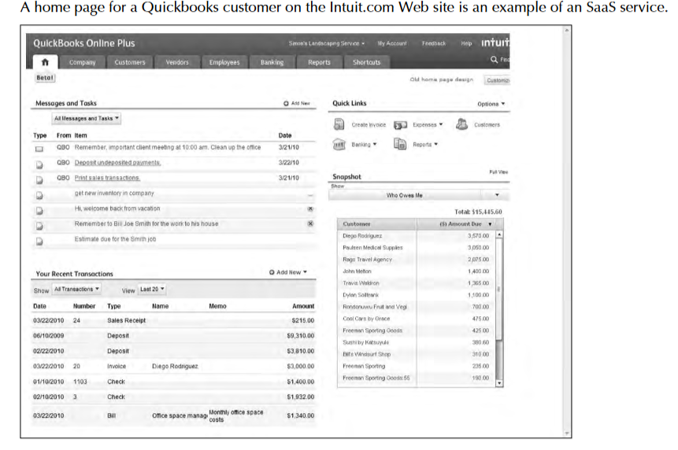
Service Models
Figure shows a home page for QuickBooks Online plus on the Intuit.com Web site.

Slide 19
Service Models
A client using an SaaS service might as is the case for Quickbooks online log into the service from his browser, create an account, and enter data into the system.
Intuit.com has a service agreement that not only covers the performance of the hardware and software, but extends to protecting the data that they store for clients, and other fundamental characteristics.
Other good examples of SaaS cloud service providers are: GoogleApps, Oracle On Demand SalesForce.com, SQL Azur.
These service model classifications start to get confusing rather quickly when you have a cloud service provider that starts out offering services in one area and then develops services that are classified as another type.
For example, SalesForce.com started out as a Customer Relationship Management SaaS platform that allowed clients to add their own applications.
Over time SalesForce.com opened an API called the Force API that allowed developers to create applications based on the SalesForce.com technologies. Force.com is thus their PaaS service.

Slide 20
Service Models
As another example, take the PaaS offering that is the Windows Azure Platform.
Windows Azure Platform allows .NET developers to stage their applications on top of Microsoft’s infrastructure so that any application built with the .NET Framework can live locally, in Microsoft’s cloud network or some combination thereof.
As Microsoft adds enterprise applications to its cloud service portfolio, as it has in the case of SQL Azure (and many other enterprise applications to come), these offerings fall under the rubric of being an SaaS service model.

Slide 21
Service Models-Differences
Basis Of | IAAS | PAAS | SAAS
Stands for | Infrastructure as a service. | Platform as a service. | Software as a service.
Uses | IAAS is used by network architects. | PAAS is used by developers. | SAAS is used by the end user.
Access | IAAS gives access to the resources like virtual machines and virtual storage. | PAAS gives access to run time environment to deployment and development tools for application. | SAAS gives access to the end user.
Model | It is a service model that provides virtualized computing resources over the internet. | It is a cloud computing model that delivers tools that are used for the development of applications. | It is a service model in cloud computing that hosts software to make it available to clients.
Technical understanding. | It requires technical knowledge. | Some knowledge is required for the basic setup. | There is no requirement about technicalities company handles everything.
Popularity | It is popular among developers and researchers. | It is popular among developers who focus on the development of apps and scripts. | It is popular among consumers and companies, such as file sharing, email, and networking.
Percentage rise | It has around a 12% increment. | It has around 32% increment. | It has about a 27 % rise in the cloud computing model.
Usage | Used by the skilled developer to develop unique applications. | Used by mid-level developers to build applications. | Used among the users of entertainment.
Cloud services. | Amazon Web Services, sun, vCloud Express. | Facebook, and Google search engine. | MS Office web, Facebook and Google Apps.
Enterprise services. | AWS virtual private cloud. | Microsoft Azure. | IBM cloud analysis.
Outsourced cloud services. | Salesforce | Force.com, Gigaspaces. | AWS, Terremark
User Controls | Operating System, Runtime, Middleware, and Application data | Data of the application | Nothing
Others | It is highly scalable and flexible. | It is highly scalable to suit the different businesses according to resources. | It is highly scalable to suit the small, mid and enterprise level business

